Slide 1
Our course is Linguistics of discourse

Slide 2
Lecture 7-8
THE STRUCTURE
OF THE SPEECH ACT

Slide 3
Test
A speech act is …
a) a sentence as a structural phenomenon
b) a verb
c) an utterance with a purpose
d) a text

Slide 4
2. A direct speech act is …
a) the intended meaning matches the form
b) a question implies a directive
c) a statement is used instead of a question
d) you indirectly understand the intended meaning

Slide 5
2. A direct speech act is …
a) a question is a directive
b) a question is a question
c) a question isn’t a question
d) a question is a question + something else

Slide 6
3. An indirect speech act is …
a) the intended meaning matches the form
b) you directly understand the intended meaning
c) a question is a question
d) you indirectly understand the intended meaning

Slide 7
5. The main types of speech act are …
a) assertive, directive, promissive, declarative, expressive
b) verbs, nouns, adjectives, adverbs, pronouns
c) subject, predicate, attribute, object, adverbial modifier

Slide 8
6. An assertive …
a) conveys information
b) demands action
c) demands information
d) shows emotions and feelings
e) assuring that one will or will not do something

Slide 9
7. A question…
a) coveys information
b) demands action
c) demands information
d) shows emotions and feelings
e) assuring that one will or will not do something

Slide 10
8. An expressive…
a) conveys information
b) demands action
c) demands information
d) shows emotions and feelings
e) assuring that one will or will not do something

Slide 11
9. A promissive…
a) conveys information
b) demands action
c) demands information
d) shows emotions and feelings
e) assuring that one will or will not do something

Slide 12
10. A directive …
a) conveys information
b) demands action
c) demands information
d) shows emotions and feelings
e) assuring that one will or will not do something

Slide 13
11. What speech acts can you find in this dialogue? (assertive, interrogative, expressive, declarative, promissive – promise , menacive – threat )
Dialogue
- "Hi, Richard," she said, and spit out a mouthful of toothpaste. She was wearing cut-off jeans that had bizarre, frantic designs drawn on them in Magic Marker and a spandex top.
- "Hello," I said, setting to work on my tie.
- "You look cute today."
- "Thanks”.
- "Got a date?"
- I looked away from the mirror, at her. "What!?"
- "Where are you going?"

Slide 14
12. A performative is a speech act…
a) which has no verb (predicate)
b) which is an ordinary statement
c) with two subjects and two predicates
d) in which a verb denotes an action

Slide 15
13. Pick out all the performative utterances:
I order you to go.
I swear to do that.
I am happy.
I appoint you the manager of the department.
It is raining.
I believe you.
Tomorrow is Thursday.
I apologize.
I welcome you.
I advise you to do it.

Slide 16
Lecture 4
THE STRUCTURE
OF THE SPEECH ACT

Slide 17
Questions to discuss
1) What is locution?
2) What is illocution?
3) What is perlocution?

Slide 18
Question 1
What is locution (locutionary act)?

Slide 19
Each speech act consists of three components (has a three-layer structure):
- locution (locutionary act),
- illocution (illocutionary act),
- perlocution (perlocutionary act).

Slide 20
Locution (locutionary act)

Slide 21
Locution (locutionary act) is the objective content of the statement, its literal meaning.

Slide 22
My telephone is broken.

Slide 23
Do you have a telephone?

Slide 24
Question 2
What is an illocution?

Slide 25
An illocutionary act is a true communicative intention of the speaker (directive, regret, surprise, simple statement, etc.)

Slide 26
One locution can represent different illocutions (illocutionary acts).

Slide 27
For example, the locution “My telephone’s broken” can mean:
1) a statement “I need a new one”;
2) a statement “I won’t be able to call you in the evening”
3) a request “Please, help me to fix it”;
4) a request “Can I use your phone?”

Slide 28
Exercise 1. What illocutionary force can the following speech acts have?
Our exam is tomorrow. (warning?)
Where is the money?
How can I help you?
It is already 4 p.m.
The key is there.
“It’s cold in here, isn’t it?”

Slide 29
The illocution of the speech act depends on a particular speech situation.

Slide 30
To interpret a sentence in a proper way, we should take into account the participants of the communication, their intentions, the time and place of the communication and other factors.

Slide 31
Misinterpretation (complete or partial) of the illocutionary force (communicative goal) of a speech act is known as a communicative (conversational) failure.

Slide 32
Dialogue 1
A: I am ready.
B: I see. As for me, I have to do a lot of things yet.
A: Why are you angry?
B: Because you want me to hurry up.
A: No, I didn’t mean that. I mean that I am free and I can help you.

Slide 33
Dialogue 2
A: Why are you baking the potatoes with the salt?
B: You don’t have to eat it, if you don’t want to.
A: Why do you think that I don’t want to? I do want. I simply mean where did you get the recipe?

Slide 34
“We human beings are odd compared with our nearest animal relatives. Unlike them, we can say what we want, when we want. All normal humans can produce and understand any number of new words and sentences. Humans use the multiple options of language often without thinking. But blindly, they sometimes fall into its traps. They are like spiders who exploit their webs, but themselves get caught in the sticky strands.” (Jean Aitchison)

Slide 35
Use an indirect speech act
Requesting a second opinion (e.g., from another doctor at the hospital when the diagnosis for your loved one’s situation is unacceptable to you).
Complaining (e.g., to the manager of a pricey restaurant manager about slow service and mediocre food).

Slide 36
Use an indirect speech act
Tell your boss that you don’t want to this job.
Tell your friend that you can’t give him back the money that he lent you last week.
Tell your colleague that you can’t help him with his duties.

Slide 37
The intensity of the illocutionary force: the oath "I swear to you that it was Bob who did it" sounds more intensive and will be more effective than the supposition "I think that it was Bob who did it". One more example: You can persuade your parents to buy a new smartphone with a mere request, or you can beg them.

Slide 38
Question 3
What is perlocution?

Slide 39
Perlocution (perlocutionary act) is the reaction of the speaker to a particular speech act.

Slide 40
So, a person who has heard a message about the telephone that is broken can react to it in different ways: to believe or not to believe, to buy or to refuse a new telephone for the speaker, to recommend a new telephone, etc.

Slide 41
What is a possible perlocution?
You arranged to meet a friend in order to study together for an exam. You arrive half an hour late for the meeting.
Friend (annoyed): I’ve been waiting at least half an hour for you!
You-1: So what! It's only an – a meeting for – to study.

Slide 42
Friend: Well, I was standing here waiting. I could have been doing something else.
You-2: Yeah, I'm sorry. But don't make such a big deal of it.
Friend: Well, it’s pretty annoying. Try to come on time next time.

Slide 43
Here are responses to You-1 and You-2, provided by a native speaker of Hebrew:
You-1: So what! It's only an – a meeting for – to study.
You-2: Yeah, I'm sorry. But don't make such a big deal of it.

Slide 44
Respond appropriately and effectively to a speech act:
Your friend tells you:
Tomorrow is a pay-day.

Slide 45
Respond appropriately and effectively to a speech act:
Your friend tells you:
Tomorrow is a pay-day (let’s go out somewhere)

Slide 46
Respond appropriately and effectively to a speech act:
Your friend tells you:
Tomorrow is a pay-day (=are you going to give me back the money I gave you last week?).

Slide 47
Respond appropriately and effectively to a speech act:
It is snowing again (=unfortunately, we can’t go out).

Slide 48
Respond appropriately and effectively to a speech act:
It is snowing again (=we can make a beautiful snowman).

Slide 49
So, the 3 components of speech acts:
- locution (locutionary act),
- illocution (illocutionary act),
- perlocution (perlocutionary act)

Slide 50
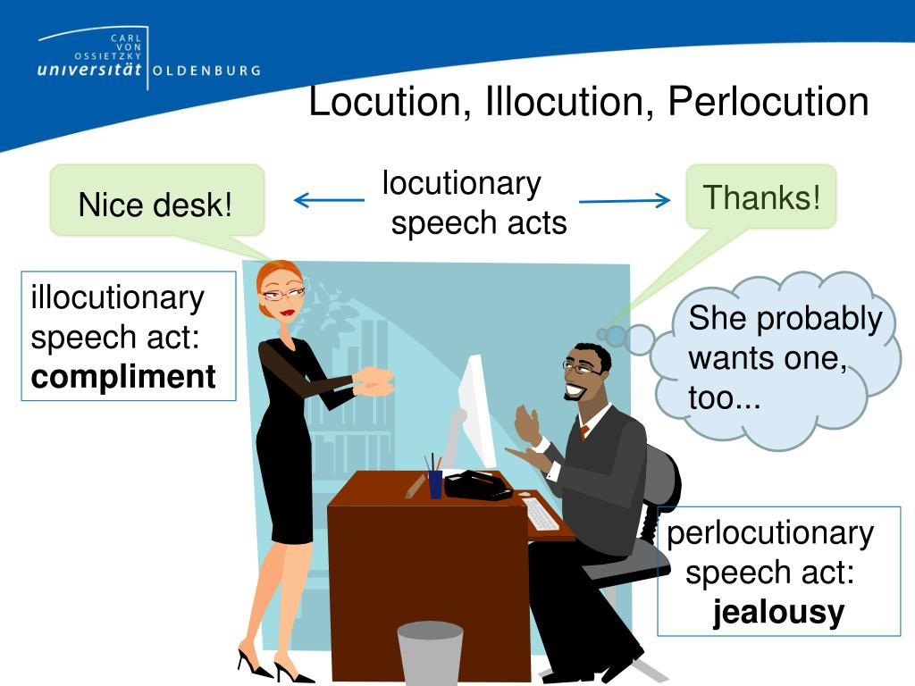

Slide 51
Please, be quite!
Locution – be quite
Illocution is – stop talking
Perlocution – the reaction

Slide 52
That is enough for today.
Locution – That is enough for today
Illocution – Our class is over
Perlocution – bye-bye

Slide 53
There’s a bull in the yard.

Slide 54

a speech act = an illocutionary act

Slide 55
Summary
1. The 3 main types of speech act are:
- locution
- illocution
- perlocution
2. The main component of a speech act is illocution.

Slide 56
Quiz

Slide 57
Choose the correct statement:
a) A locution can have different illocutions.
b) Any locution can represent an endless number of illocutions.
c) Locution isn’t an instrument for representing an illocution.

Slide 58
2. A locution is …
a) the objective content of the statement, its literal meaning
b) a true communicative intention of the speaker
c) the reaction of the speaker to a particular speech act

Slide 59
3. An illocution is …
a) the objective content of the statement, its literal meaning
b) a true communicative intention of the speaker
c) the reaction of the speaker to a particular speech act

Slide 60
4. A perlocution is …
a) the objective content of the statement, its literal meaning
b) a true communicative intention of the speaker
c) the reaction of the speaker to a particular speech act

Slide 61
5. Of all three acts (locution, illocution and perlocution), what is speech act theory most concerned with?
locution,
illocution,
perlocution

Slide 62
6. The main component of a speech act:
locution,
illocution,
perlocution

Slide 63
8. The three components of the speech act were proposed by:
John Searle
John Austin
Edward Sapir

Slide 64
9. Which sentence can be used as a request?
I’m freezing.
b) It’s nice.
c) Thank you very much.

Slide 65
10. An illocutionary act is identical with …
a) sentence meaning
b) the speaker’s intention
c) language understanding
d) the speaker’s attitude

Slide 66
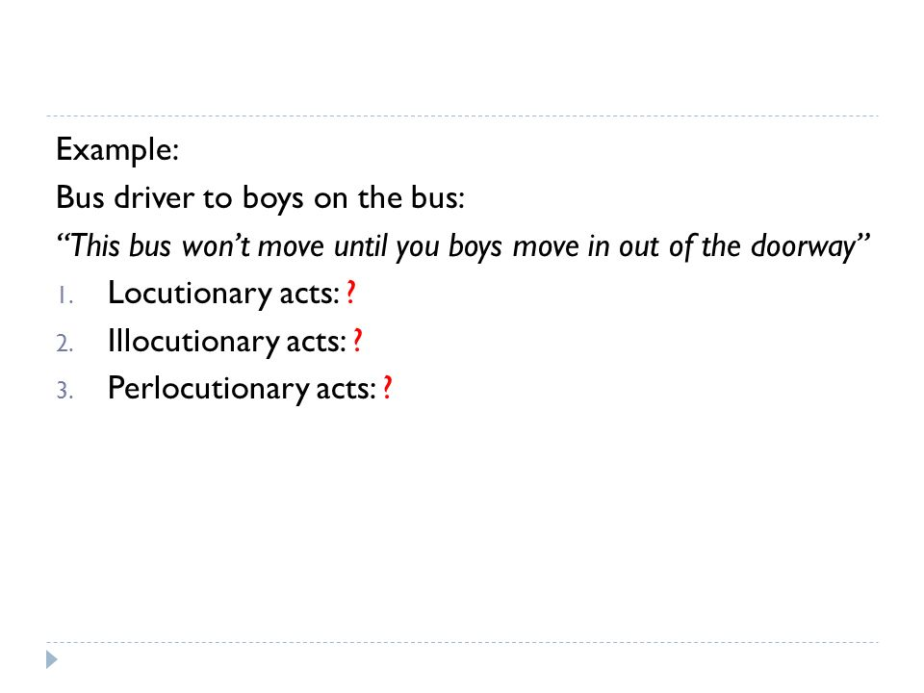

Slide 67
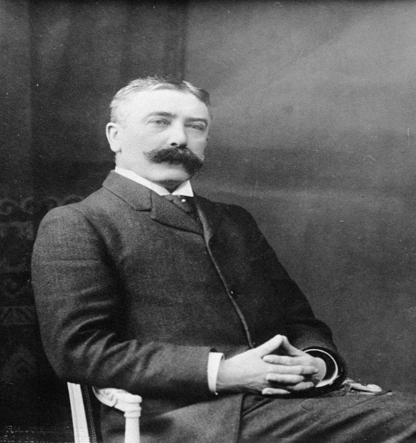
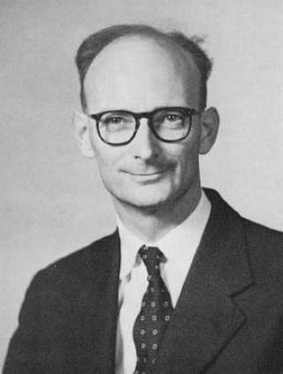
12. Find the picture of John Austin:
a)
b)

